Slide 1

Practice of Deep Learning Day 2, Part 2/4
Matthieu De Mari

Slide 2
About this lecture
What is the PyTorch library and its benefits?
What is a PyTorch tensor object and its typical attributes?
How to implement some typical tensor operations?
What are tensor locations in terms of computation?
How to transform our original NumPy shallow Neural Network class so it uses PyTorch now instead?
How to implement a forward, loss and accuracy metric in PyTorch?
What are some measurable performance benefits of using PyTorch over NumPy and GPUs over CPUs?

Slide 3
About this lecture
What is the autograd/backprop module in PyTorch, and how does it use a computational graph to compute all derivatives?
How to use the autograd to implement derivatives and a vanilla gradient descent?
How to implement backprop in PyTorch for our shallow Neural Network class?
How to finally revise our trainer function to obtain a minimal, yet complete Neural Network in PyTorch?
How to implement building blocks in PyTorch?
How to implement and train our first Deep Neural Network?

Slide 4

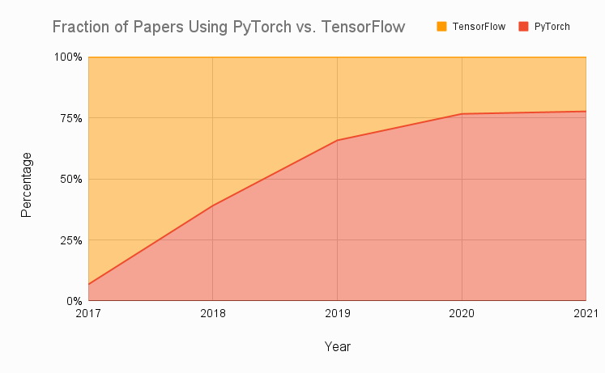
Technical pre-requisites
Framework of choice will be PyTorch! (not Tensorflow, not Keras, not MXNet, etc.)
Increasing popularity and preferred to Google’s Tensorflow these days for many reasons.
Learn more, if curious: https://www.assemblyai.com/blog/pytorch-vs-tensorflow-in-2022/

Slide 5
On the benefits of using PyTorch
There are several benefits to using PyTorch over NumPy for implementing neural networks:
More intuitive interface for working with tensors and neural networks.
NumPy is primarily a numerical computing library.
PyTorch is specifically designed with deep learning and provides a more natural and convenient interface.
Large active community of users.
Many tutorials, detailed documentations and implementations on Github.
Stack overflow equivalent.

Slide 6
On the benefits of using PyTorch
There are several benefits to using PyTorch over NumPy for implementing neural networks:
PyTorch has better support for GPU acceleration than NumPy.
If a GPU is available, significantly speed up the training of our neural network by performing the computations on the GPU using PyTorch.
Especially useful for training large and complex models.
High-level abstractions for building and training neural networks.
Easier to write and debug code,
Improve the performance of our model by allowing PyTorch to apply optimization techniques
More specifically, automatic differentiation!

Slide 7
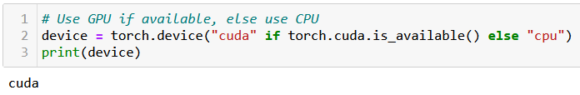
At this point, you should have installed PyTorch, and if possible, CUDA
You can check for CUDA/GPU capabilities, using the code below. If the CUDA has not been properly installed or the GPU is not compatible, you will be using a CPU instead.
We strongly advise to take a moment to make sure your machine is CUDA enabled, assuming your GPU is compatible (see W1S1 bonus).
When CUDA is properly installed on a compatible GPU, the line below should display cuda, otherwise it will print cpu.

Slide 8
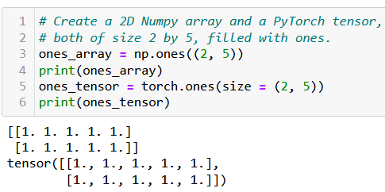
The Tensor object
Definition (Tensor):
The tensor is PyTorch's basic building block and is very similar to NumPy arrays.
This is why most of the concepts and methods will look similar
However, these come with additional features, which will be useful later on when building Neural Networks with these tensors.

Slide 9
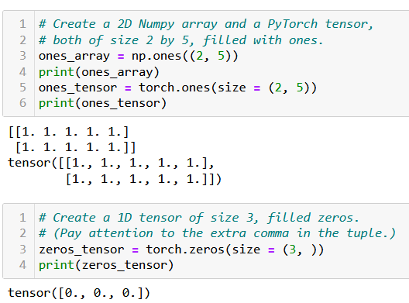
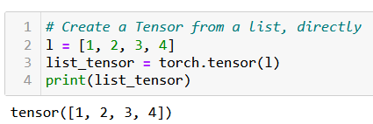
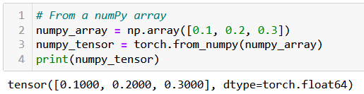
Creating a Tensor
Tensors can be simply created as in NumPy, by using zeros() or ones() functions, specifying dimensions of the expected Tensor, with tuples.
They can also be created from a list (of lists) of values, by passing it to the tensor() function.
Or from a Numpy array, using the from_numpy() method.

Slide 10
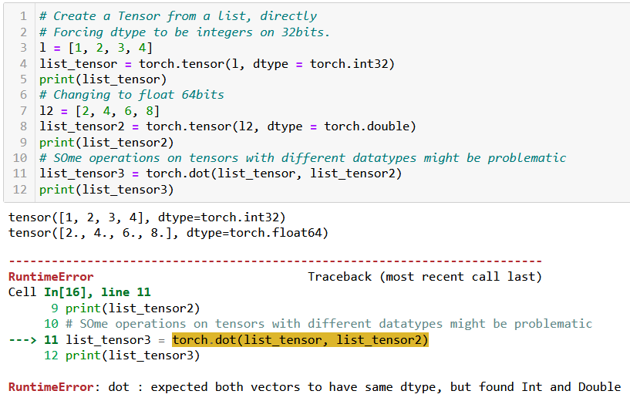
Tensor datatypes (dtypes)
Definition (dtypes):
PyTorch tensors have an attribute called dtype, which tracks the datatype of values stored in the tensor.
See link below for more details on the possible dtypes. https://www.tensorflow.org/api_docs/python/tf/dtypes
In general, operations between tensors require compatible, and sometimes identical dtypes.
Here, the dot product failed because one tensor was int, and the other was float/double.

Slide 11
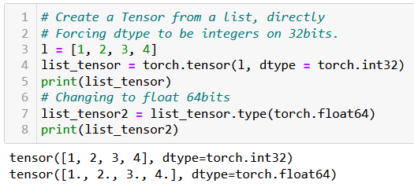
Tensor datatypes (dtypes)
Definition (dtypes):
PyTorch tensors have an attribute called dtype, which tracks the datatype of values stored in the tensor.
See link below for more details on the possible dtypes. https://www.tensorflow.org/api_docs/python/tf/dtypes
In general, operations between tensors require compatible, and sometimes identical dtypes.
You can change the dtype of a tensor
- by either specifying it explicitly during its creation;
- or by using the type() method on the tensor, casting a new dtype.

Slide 12
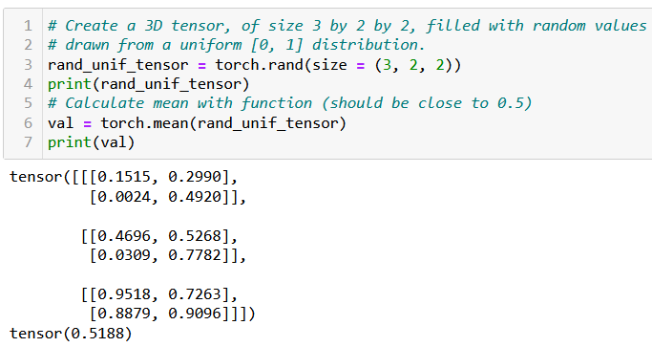
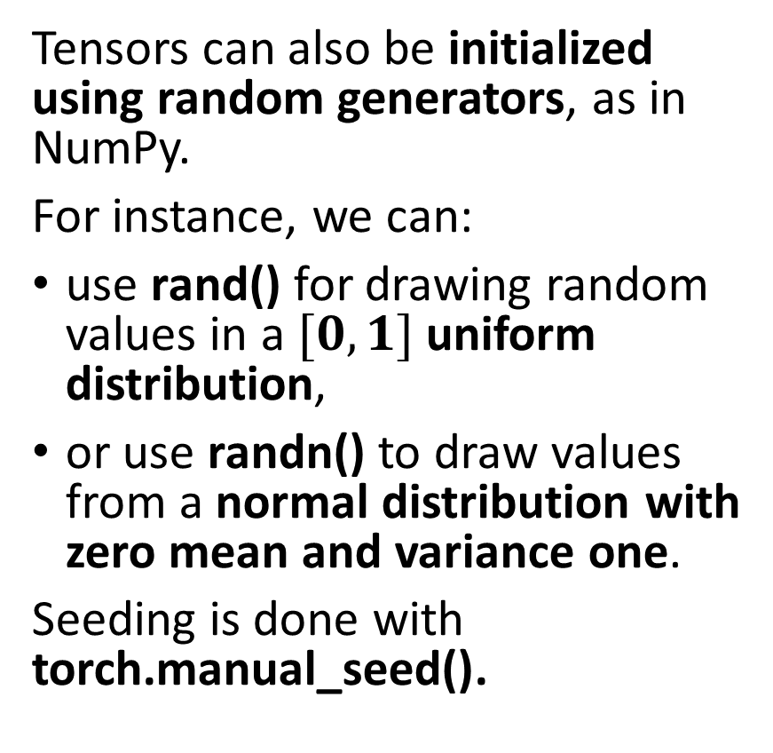
Tensor random initializers
Tensors can also be initialized using random generators, as in NumPy.
For instance, we can:
use rand() for drawing random values in a $[0, 1]$uniform distribution,
or use randn() to draw values from a normal distribution with zero mean and variance one.
Seeding is done with torch.manual_seed().
Functions and methods exist for calculating mean values of a tensor, its standard deviation/variance, etc.

Slide 13
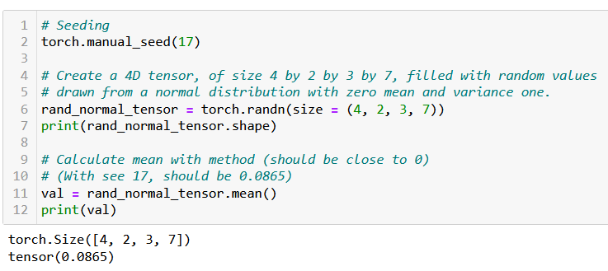
Tensor random initializers
Tensors can also be initialized using random generators, as in NumPy.
For instance, we can:
use rand() for drawing random values in a $[0, 1]$uniform distribution,
or use randn() to draw values from a normal distribution with zero mean and variance one.
Seeding is done with torch.manual_seed().
Functions and methods exist for calculating mean values of a tensor, its standard deviation/variance, etc.

Slide 14

Additional attributes of Tensors
Tensors come with many attributes and methods, e.g. asking the shape of a tensor, like in NumPy, is done using the shape attribute.
Not planning to cover all of these attributes and methods, because…

Slide 15
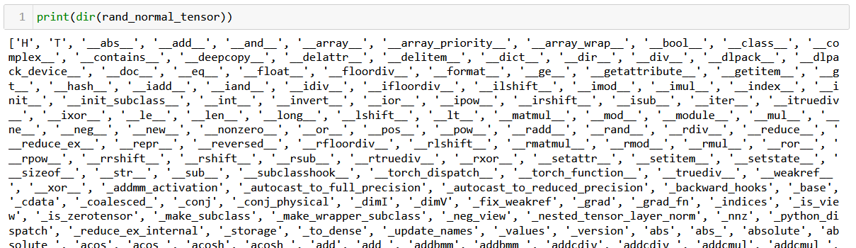
Additional attributes of Tensors
Tensors come with many attributes and methods, e.g. asking the shape of a tensor, like in NumPy, is done using the shape attribute.
Too many of them for me to cover, so RTFM!

Slide 16
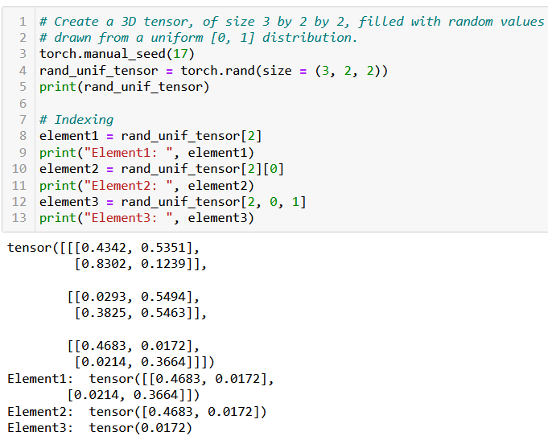
Basic operations on Tensors
All the typical element-wise operations on arrays work on tensors. For instance, we can:
access elements using the square bracket notation, multiple square bracket notations and multiple indexes in a single square bracket;
slice a tensor using the square bracket notation and colon symbol;
update elements of a tensor using the square bracket notation;
browse through elements of a tensor using a for loop.

Slide 17
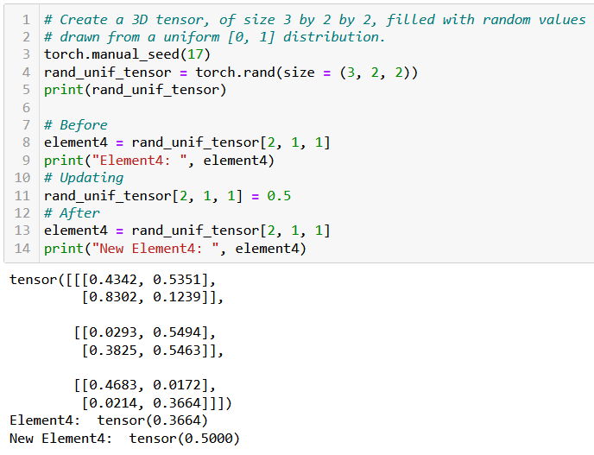
Basic operations on Tensors
All the typical element-wise operations on arrays work on tensors. For instance, we can:
access elements using the square bracket notation, multiple square bracket notations and multiple indexes in a single square bracket;
update elements of a tensor using the square bracket notation;
browse through elements of a tensor using a for loop.

Slide 18
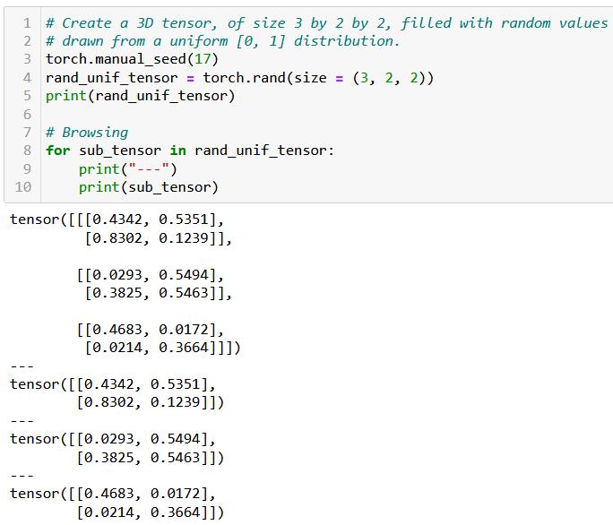
Basic operations on Tensors
All the typical element-wise operations on arrays work on tensors. For instance, we can:
access elements using the square bracket notation, multiple square bracket notations and multiple indexes in a single square bracket;
update elements of a tensor using the square bracket notation;
browse through elements of a tensor using a for loop.

Slide 19

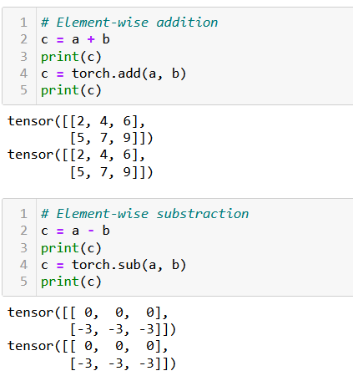
Arithmetic operations on Tensors
All NumPy array operations work on Tensors and equivalent methods have been written in torch as well.
Element-wise Addition/Subtraction,

Slide 20
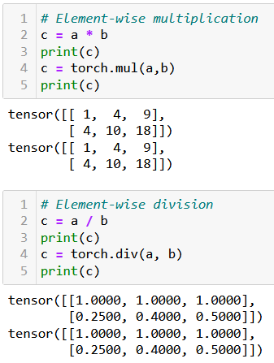
Arithmetic operations on Tensors
All NumPy array operations work on Tensors and equivalent methods have been written in torch as well.
Element-wise Addition/Subtraction,
Element-wise Multiplication/Division,

Slide 21
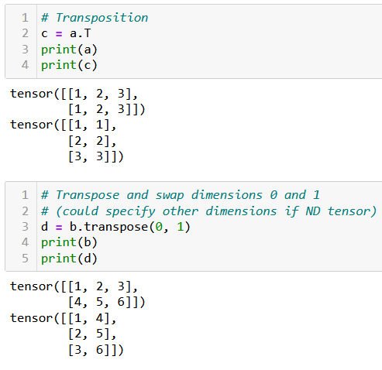
Arithmetic operations on Tensors
All NumPy array operations work on Tensors and equivalent methods have been written in torch as well.
Element-wise Addition/Subtraction,
Element-wise Multiplication/Division,
Transposition,

Slide 22
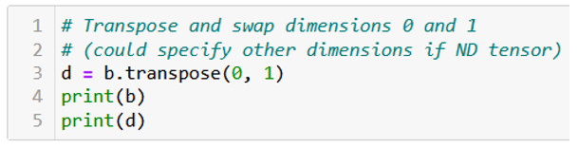
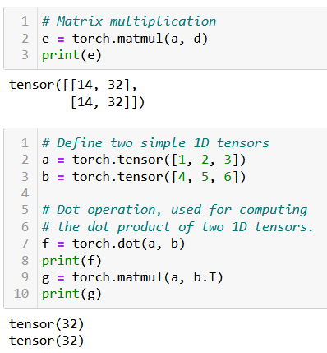
Arithmetic operations on Tensors
All NumPy array operations work on Tensors and equivalent methods have been written in torch as well.
Element-wise Addition/Subtraction,
Element-wise Multiplication/Division,
Transposition,
Matrix multiplication and dot product,
Along with more Linear Algebra stuff (now is the time to revise!).

Slide 23

Tensor locations
Recall: PyTorch has better support for GPU acceleration than NumPy.
If a GPU is available, significantly speed up the training of our neural network by performing the computations on the GPU using PyTorch.
Especially useful for training large and complex models.

Slide 24
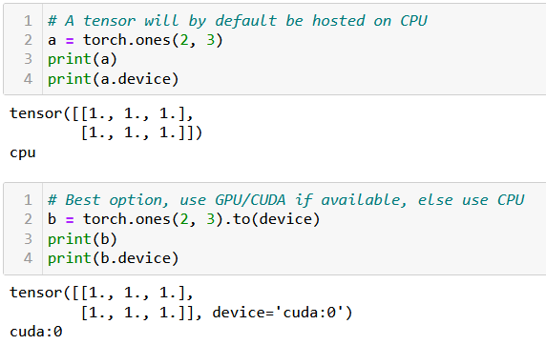
Tensor locations
By default, all tensors are used by the CPU. If device enabled for GPU/CUDA computation, transfer the tensor to the GPU for faster computation.
This is done in three ways:
Using .to(device) method will transfer to the best device available for computation (device variable was defined earlier, when we checked for cuda/cpu).
Using .cpu() or .cuda() will force transfer to the cpu or cuda respectively. Note that it might fail if you machine is not CUDA compatible.

Slide 25
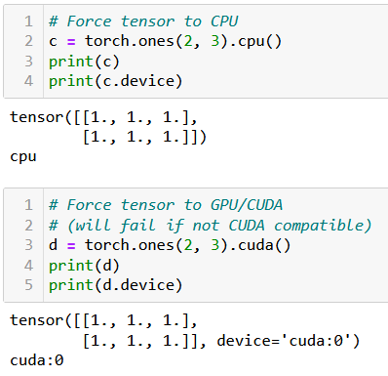
Tensor locations
By default, all tensors are used by the CPU. If device enabled for GPU/CUDA computation, transfer the tensor to the GPU for faster computation.
This is done in three ways:
Using .to(device) method will transfer to the best device available for computation (device variable was defined earlier, when we checked for cuda/cpu).
Using .cpu() or .cuda() will force transfer to the CPU or CUDA respectively. Note that it might fail if your machine is not CUDA compatible.

Slide 26
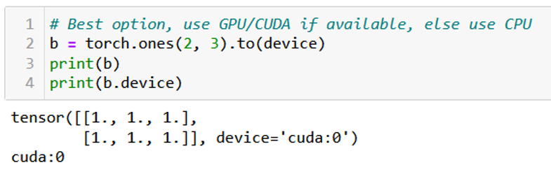
Tensor locations
By default, all tensors are used by the CPU. If device enabled for GPU/CUDA computation, transfer the tensor to the GPU for faster computation.
This is done in three ways:
Using .to(device) method will transfer to the given device for computation (device variable was typically defined earlier, when we checked for cuda/cpu).
Using .cpu() or .cuda() will force transfer to the CPU or CUDA respectively. Note that it might fail if your machine is not CUDA compatible.
In doubt, you can check the device attribute of your tensors.

Slide 27
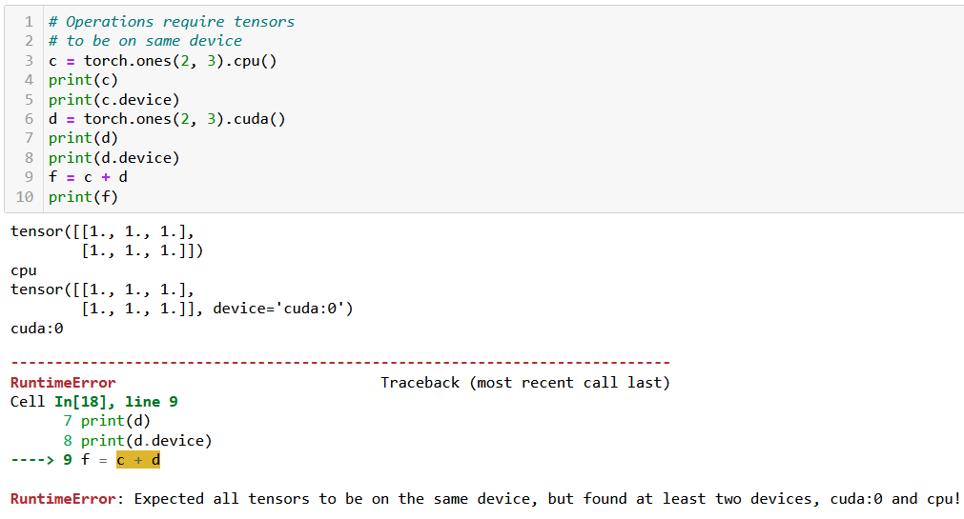
Tensor locations
Very important: two tensors with different devices cannot be used in the same operation! (same logic as with the dtypes).

Slide 28
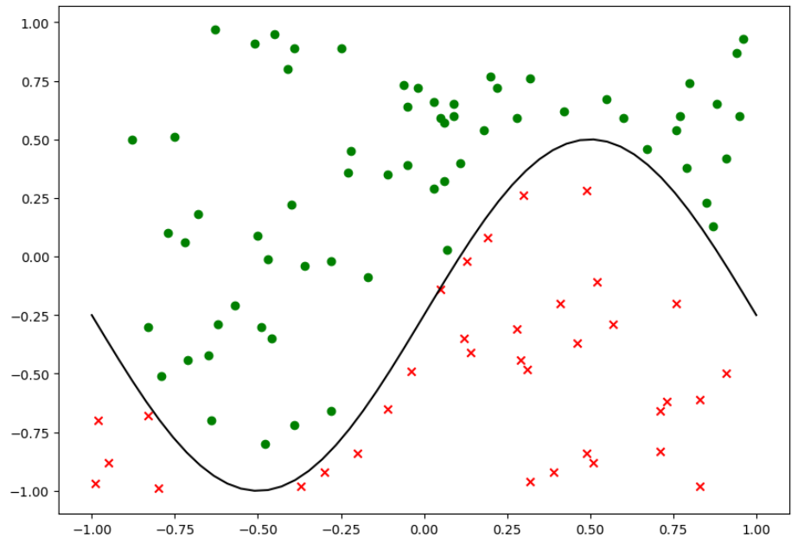
Same dataset as before

Slide 29
Our shallow neural network class
We will reuse our previous ShallowNeuralNet class from earlier, which:
implements a Shallow neural network using two fully connected layers and sigmoid activation functions,
uses a simple gradient descent algorithm for updates,
uses a random normal initialization,
comes with a forward() method for predictions,
comes with a backward() and train() method for backpropagation training,
comes with a cross-entropy loss function and an accuracy metric function,
comes with a display function, to show training curves on both the loss and the accuracy,
Let us start by replicating the init, forward, loss and accuracy methods in PyTorch.

Slide 30
Writing a PyTorch neural network
The main differences between the original class and the PyTorch version of our shallow neural network are:
The PyTorch version of the class should inherit from torch.nn.Module and call its parent's init method using super().
This is necessary because PyTorch uses classes inherited from torch.nn.Module to keep track of the layers and their parameters in a neural network.
Instead of using NumPy arrays for the weights and biases, the PyTorch version uses torch.nn.Parameter objects, which is a subclass of tensors, whose values can be trained and modified later.

Slide 31
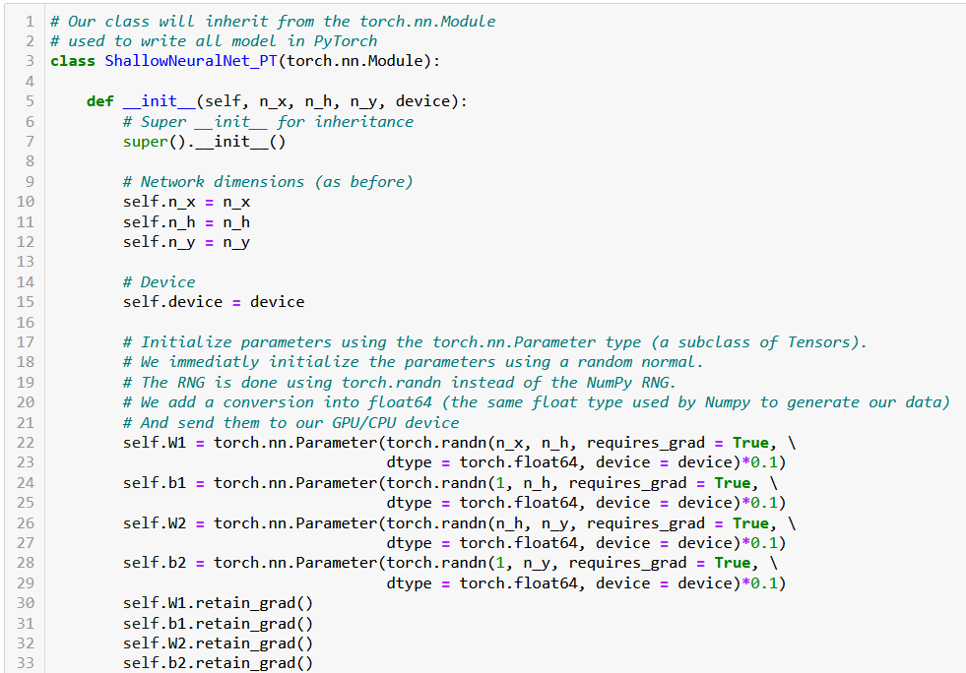
Explicitly indicate that the Wx and bx matrices are now tensors, playing the roles of parameters in a Neural Network of some sort.

Slide 32
Writing a PyTorch neural network
In PyTorch, requires_grad is an attribute of tensors that allows the gradients to be calculated for a particular tensor, during forward operations and backpropagation.
Setting retain_grad() to True for a tensor will tell PyTorch to keep track of operations happening during the forward pass, later allowing to compute the gradients of these intermediate tensors.
This will eventually serve to perform parameters updates via backpropagation.
To keep it simple: Trainable parameters should allow for gradients to be retained for backpropagation.

Slide 33
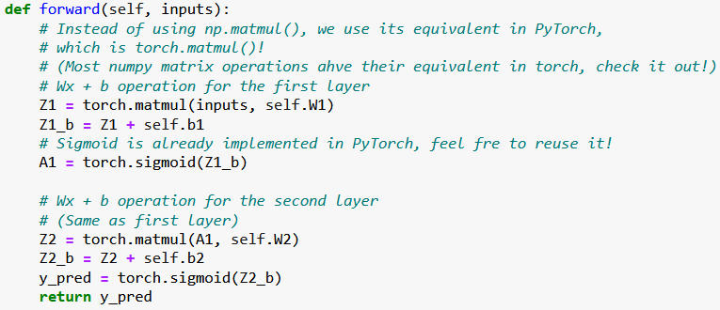
Rewriting the forward pass
The forward pass can be rewritten. You can replace most NumPy operations with their PyTorch equivalents. Similarly, our activation function sigmoid is replaced with PyTorch's torch.sigmoid() function.

Slide 34
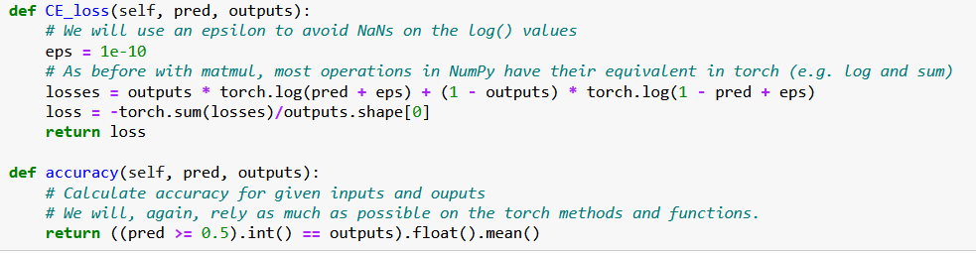
Rewriting the loss and accuracy functions
Similarly, we can rewrite the loss and accuracy functions using torch functions in place of the Numpy ones, also vectorizing operations as much as possible.

Slide 35
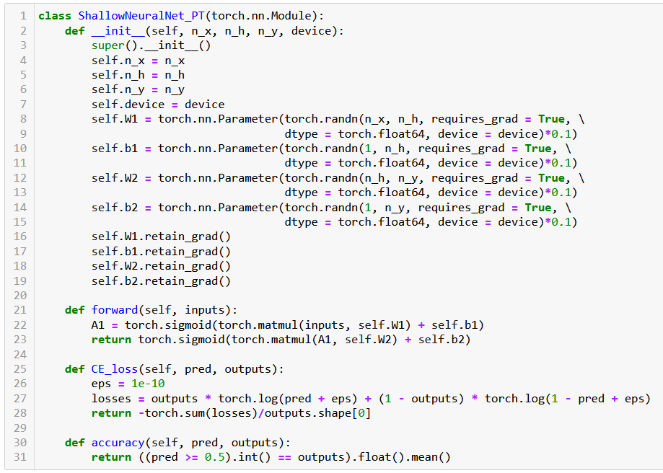

Slide 36
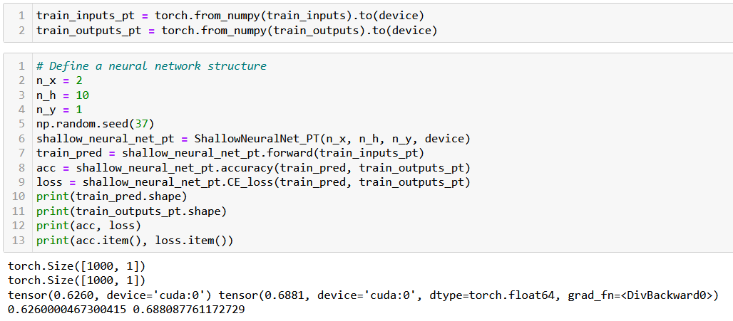
Trying out our new neural network
Before using this Neural Network on our dataset, we need to convert our samples to PyTorch Tensor objects and send them to GPU (if available).

Slide 37
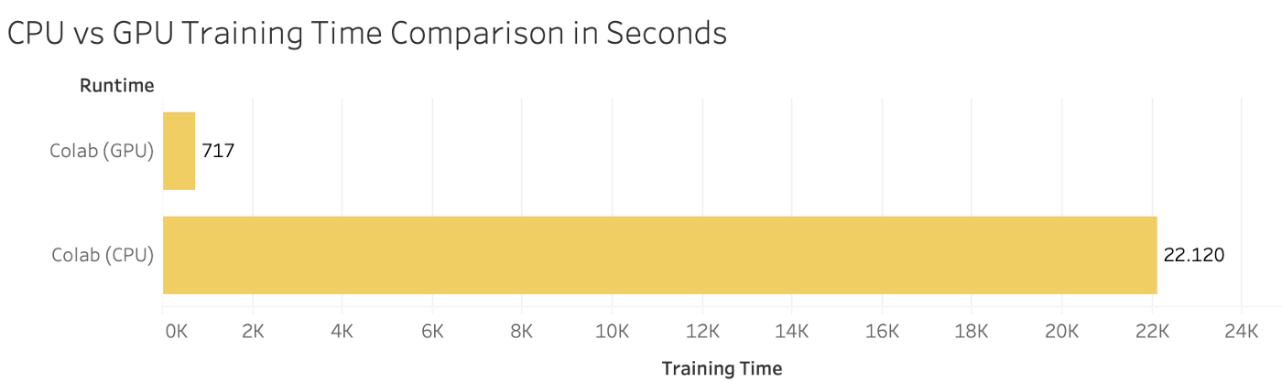
Computation times comparison
Let us run both models (the NumPy one and the PyTorch one) and ask them to perform 1000 times the accuracy computation.
On my machine (CUDA, Nvidia GTX 4070), the PyTorch model is roughly 30 times faster!
(Obviously depends on your machine, could be even more on some specific DL GPUs).

Slide 38
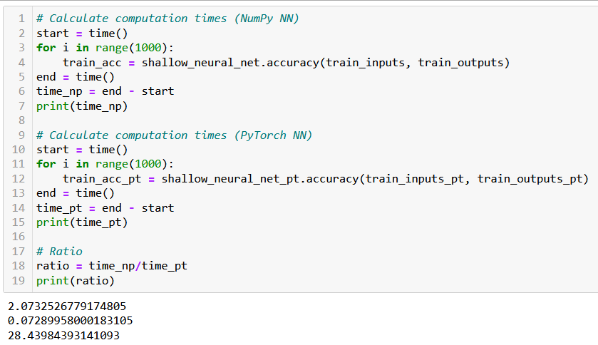
Computation times comparison

Slide 39
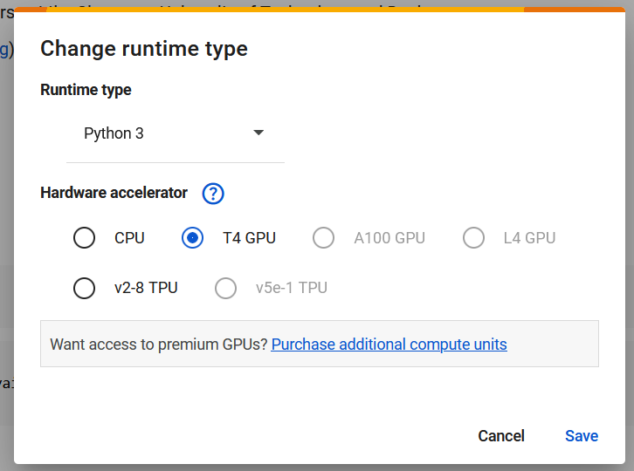
A note for those of you running on MacOS
Use Google Colab but remember to select GPUs are runtime hardware (by default CPU).
Also the option of using MPS (but you have to figure it out!)
Careful, as of Feb 2025, float64 is not a valid datatype in MPS, might need to use float32 in notebooks instead.
Possibly more adjustments needed…

Slide 40
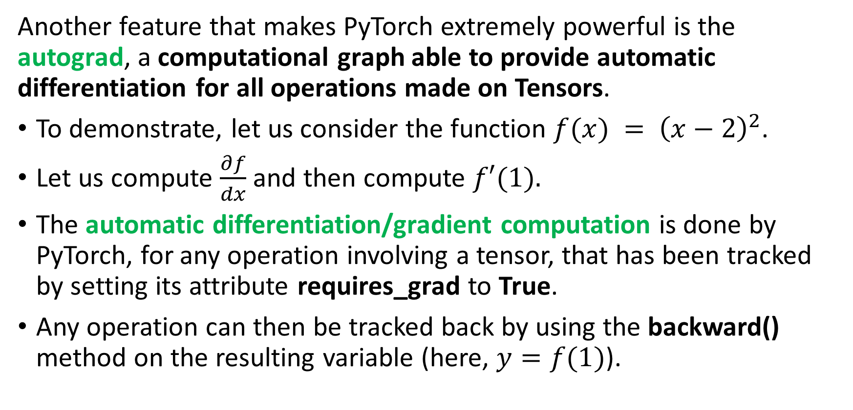
Autograd, the PyTorch beast
Another feature that makes PyTorch extremely powerful is the autograd, a computational graph able to provide automatic differentiation for all operations made on Tensors.
To demonstrate, let us consider the function $f(x) = {\left(x−2\right)}^{2}$.
Let us compute $\frac{∂f}{dx}$ and then compute $f′(1).$
The automatic differentiation/gradient computation is done by PyTorch, for any operation involving a tensor, that has been tracked by setting its attribute requires_grad to True.
Any operation can then be tracked back by using the backward() method on the resulting variable (here, $y=f(1)$).

Slide 41
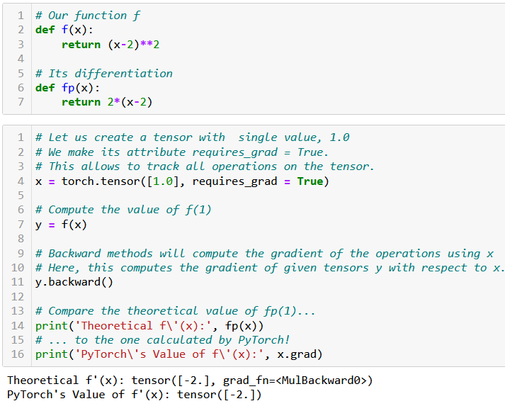
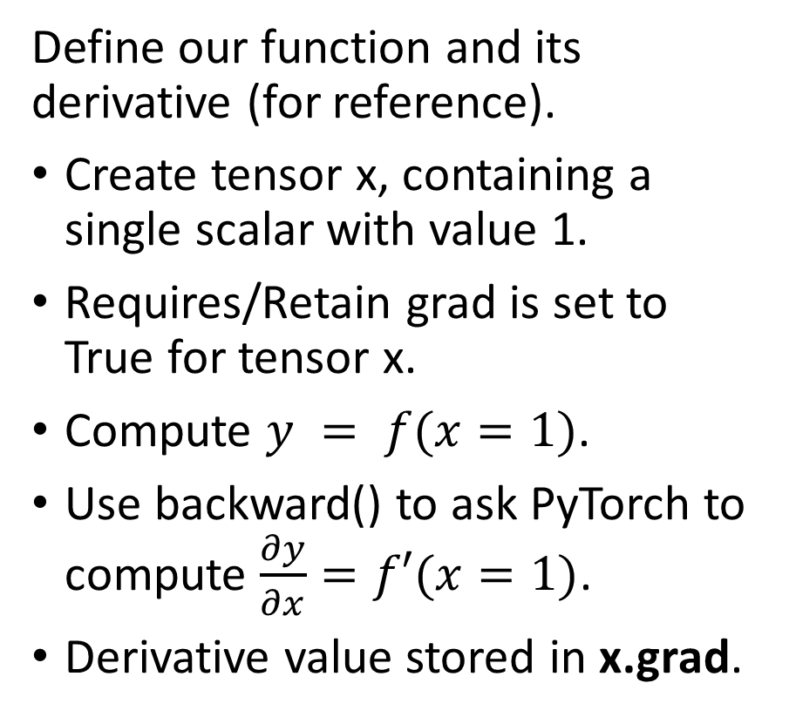
Autograd in action
Define our function and its derivative (for reference).
Create tensor x, containing a single scalar with value 1.
Requires/Retain grad is set to True for tensor x.
Compute $y = f(x=1)$.
Use backward() to ask PyTorch to compute $\frac{∂y}{∂x}=f′(x=1)$.
Derivative value stored in x.grad.

Slide 42
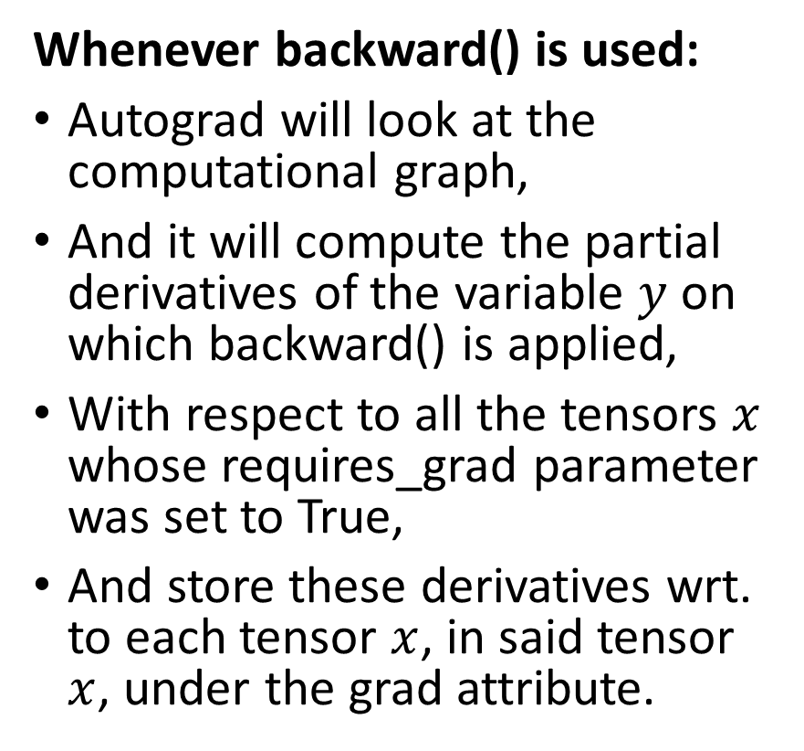
Autograd in action
Whenever backward() is used:
Autograd will look at the computational graph,
And it will compute the partial derivatives of the variable $y$ on which backward() is applied,
With respect to all the tensors $x$ whose requires_grad parameter was set to True,
And store these derivatives wrt. to each tensor $x$, in said tensor $x$, under the grad attribute.

Slide 43
Autograd, in short
The autograd is one of the most powerful features of the PyTorch framework, and why we like it so much for training Neural Networks.
Thanks to autograd, we do not need to manually calculate the gradients for any of our future gradient descent rules ever again!
The counterpart however is that all operation must involve tensors and must use PyTorch functions and methods... (but that is ok).
You do not need to know how it implements the computation of all gradients in the background, but if you are curious, have a look at: https://pytorch.org/blog/computational-graphs-constructed-in-pytorch/.

Slide 44
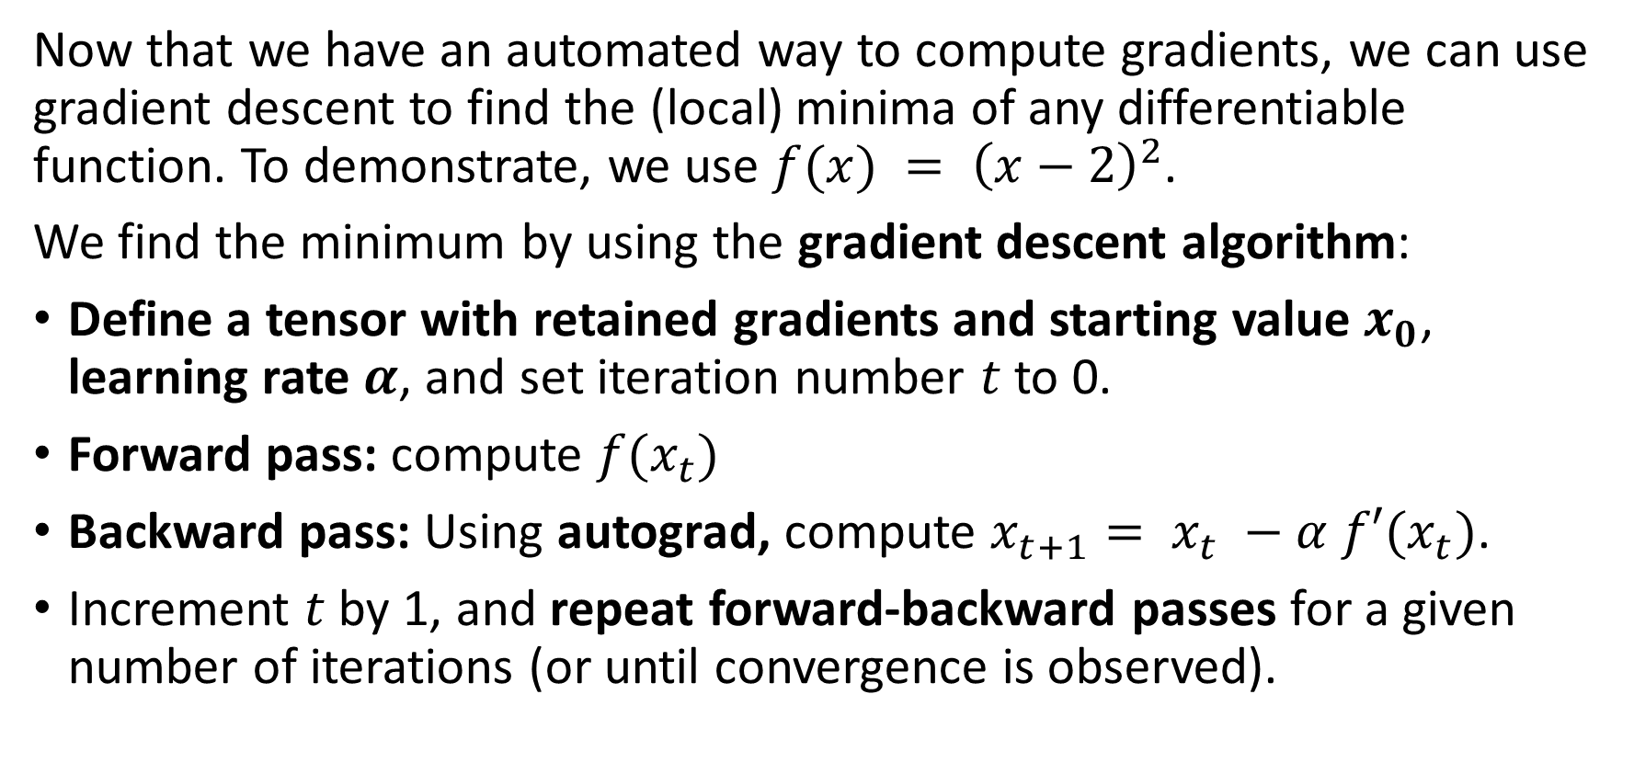
Implementing gradient descent with autograd
Now that we have an automated way to compute gradients, we can use gradient descent to find the (local) minima of any differentiable function. To demonstrate, we use $f(x) = {\left(x−2\right)}^{2}$.
We find the minimum by using the gradient descent algorithm:
Define a tensor with retained gradients and starting value $x_{0}$, learning rate $α$, and set iteration number $t$ to 0.
Forward pass: compute $f(x_{t})$
Backward pass: Using autograd, compute $x_{t+1}= x_{t} −α f′(x_{t})$.
Increment $t$ by 1, and repeat forward-backward passes for a given number of iterations (or until convergence is observed).

Slide 45
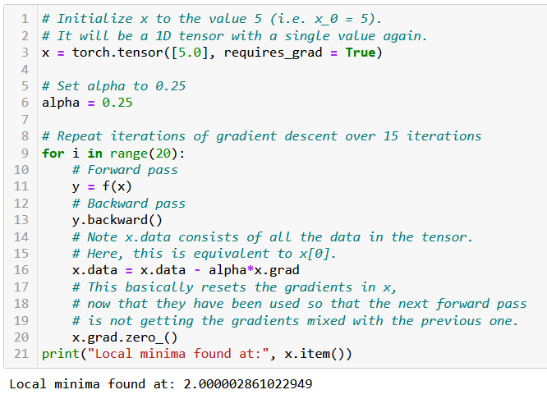
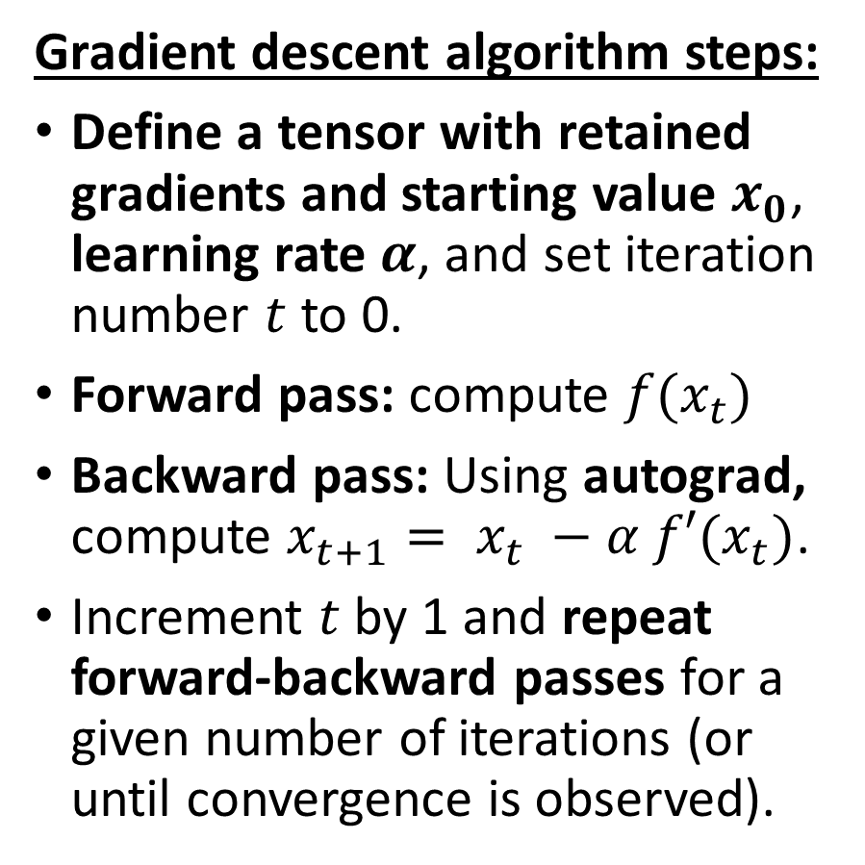
Implementing gradient descent with autograd
Gradient descent algorithm steps:
Define a tensor with retained gradients and starting value $x_{0}$, learning rate $α$, and set iteration number $t$ to 0.
Forward pass: compute $f(x_{t})$
Backward pass: Using autograd, compute $x_{t+1}= x_{t} −α f′(x_{t})$.
Increment $t$ by 1 and repeat forward-backward passes for a given number of iterations (or until convergence is observed).

Slide 46
Rewriting our backpropagation
Let us now steal this autograd and use it to make our backward method simpler! This will be great because:
There is no need for a backward() method as before to compute gradients and gradient descent update rules (built-in method for nn.Module classes, covered automatically by PyTorch autograd, yay!).
Our train() method will now simply consist of several iterations of
forward() pass and loss calculation,
gradient computation with the backward() method, used on loss,
and gradient descent updates on trainable parameters.

Slide 47
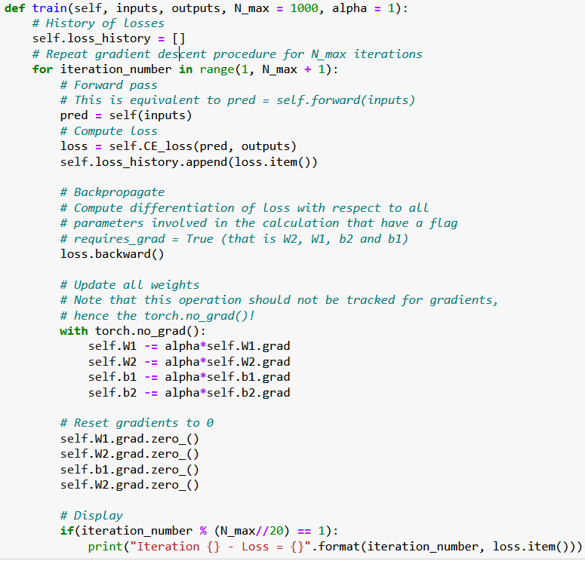
Backpropagation
Our train() method will be rewritten and now consists of several iterations of
forward() pass and loss calculation,
gradient computation with the backward() method, used on loss,
and gradient descent updates on trainable parameters.

Slide 48
Backpropagation
Important note:
Using with torch.no_grad(): tells PyTorch that the operations should not be tracked by the autograd.
Indeed, when performing gradient update for a trainable parameter, we do not want to update gradients for other trainable parameters!

Slide 49
Backpropagation
Important note #2:
Also, do not forget to reset your gradients to zero before the next iteration!
Otherwise, they will accumulate (and we do not want that!)
This can be simply done with grad.zero_().

Slide 50
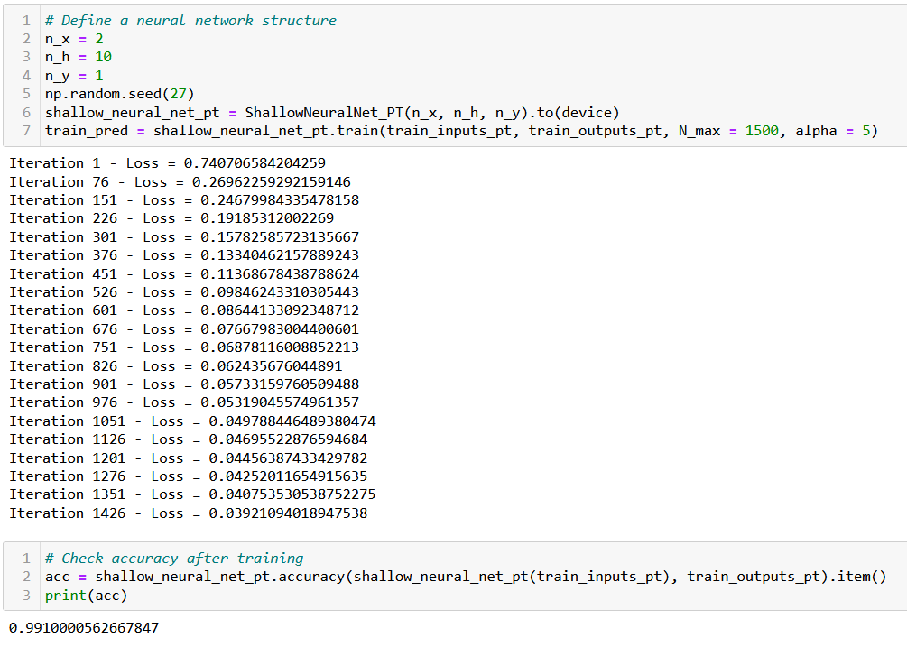
Trying our trainer function… Works!

Slide 51
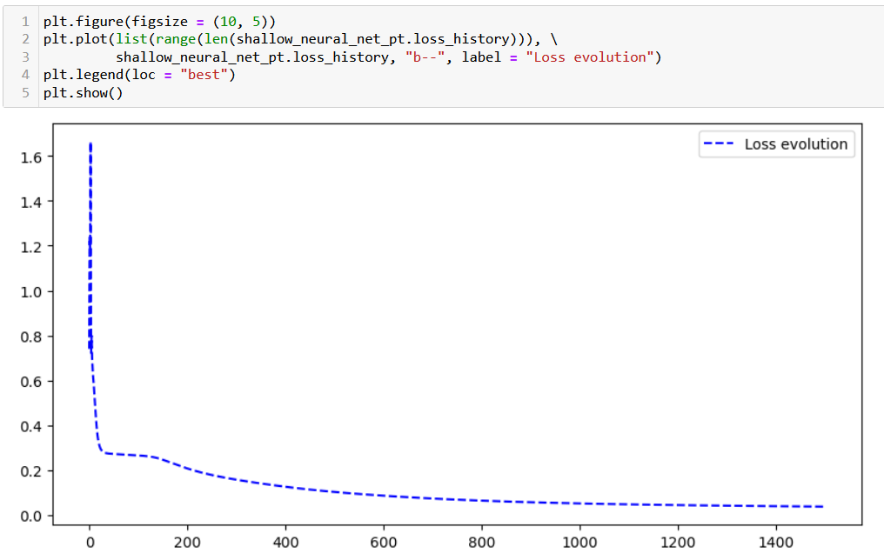
Trying our trainer function… Works!

Slide 52
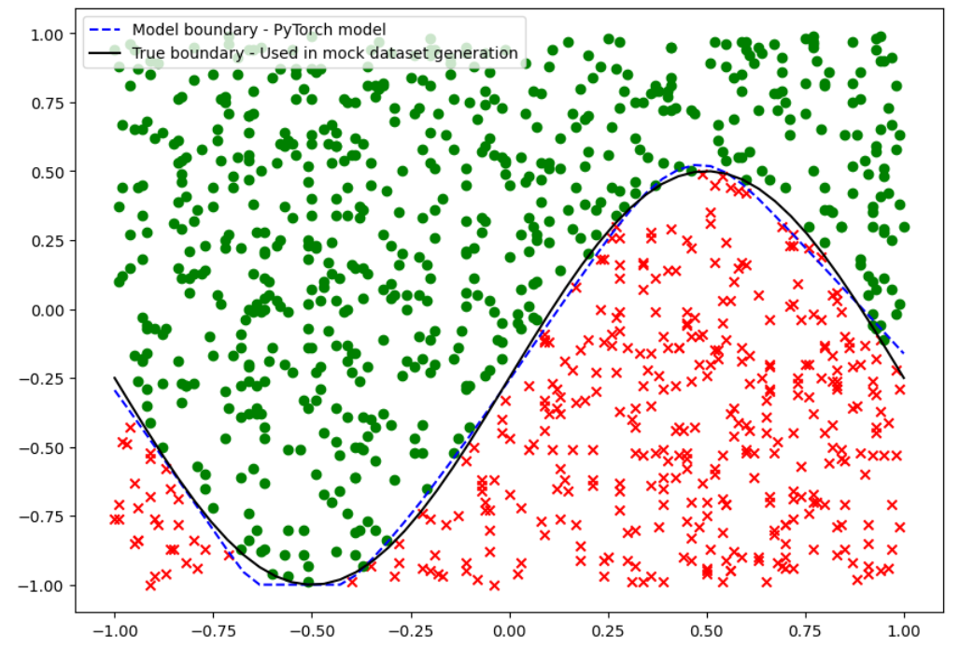
Trying our trainer function… Works!

Slide 53
Using PyTorch losses and metrics
In order to make our model even simpler and more efficient, we will use the loss functions and evaluation functions from PyTorch.
Our CE_loss() and accuracy() methods will therefore be replaced with the built-in nn.BCELoss() and the BinaryAccuracy() functions from the PyTorch and TorchMetrics libraries.
Feel free to have a look at the loss functions available in PyTorch, here: https://pytorch.org/docs/stable/nn.html#loss-functions.
Torchmetrics is a supporting library, which provides a few additional losses and metrics functions, ready to use with PyTorch: https://torchmetrics.readthedocs.io/en/stable/all-metrics.html.

Slide 54
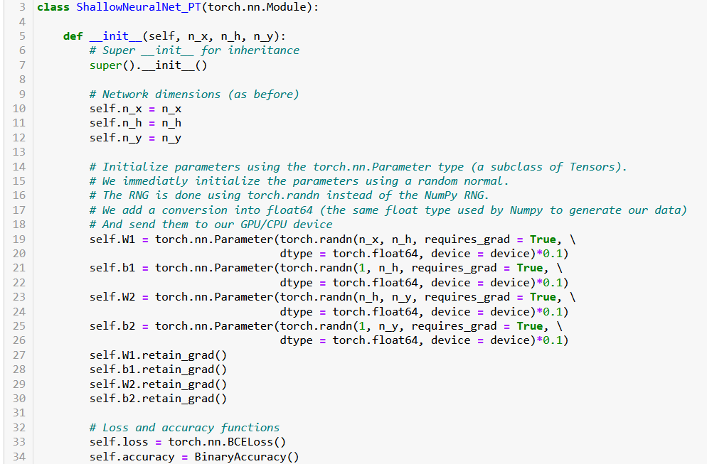

Slide 55
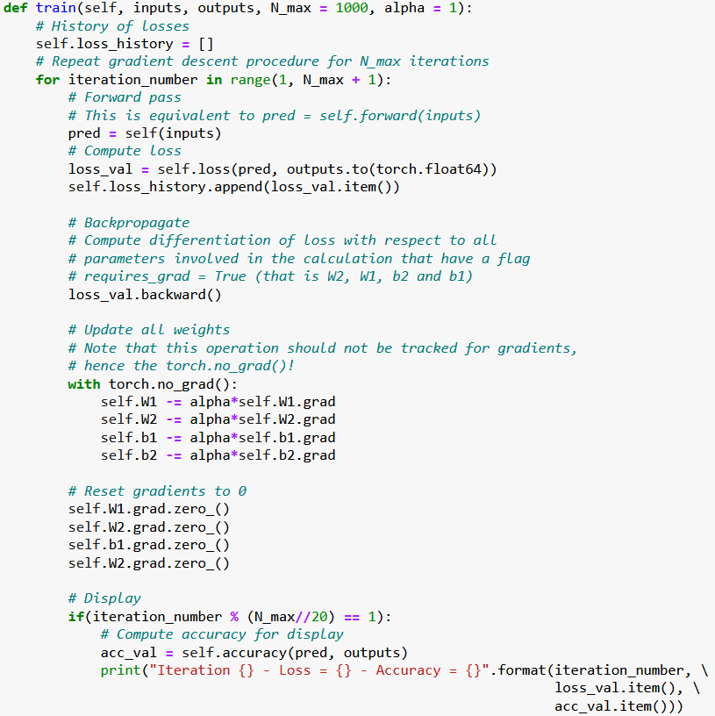

Slide 56
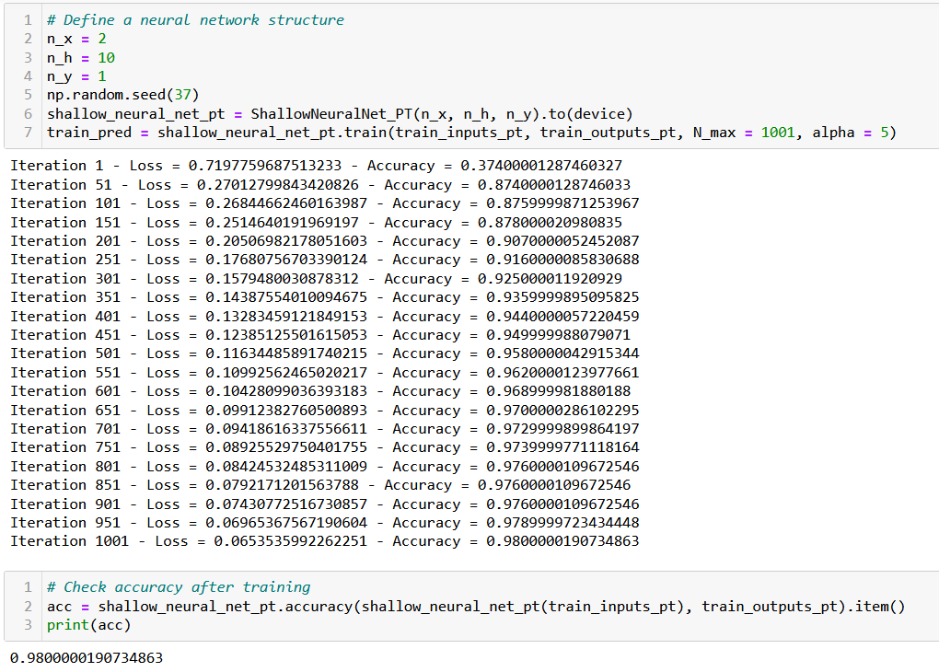

Slide 57
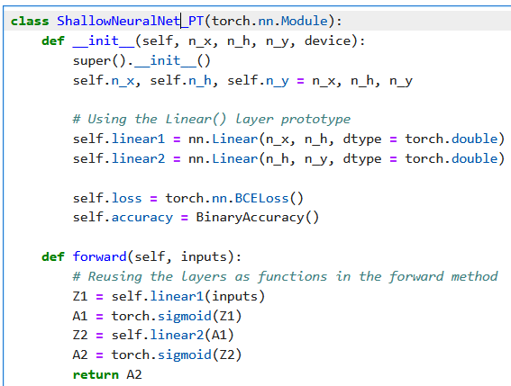
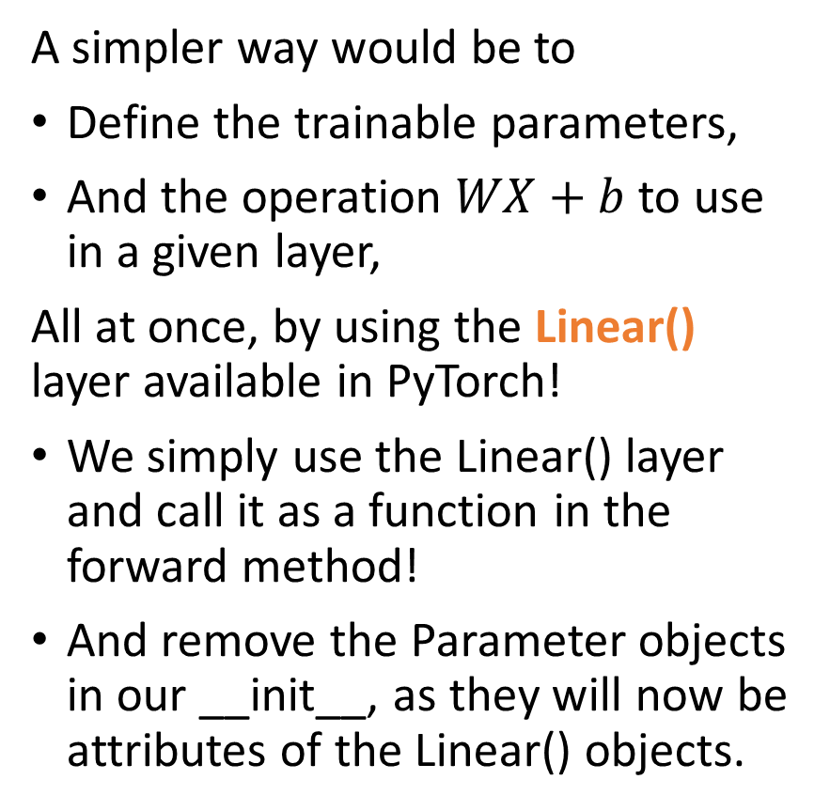
Last but not least, using layers prototypes
A simpler way would be to
Define the trainable parameters,
And the operation $WX+b$to use in a given layer,
All at once, by using the Linear() layer available in PyTorch!
We simply use the Linear() layer and call it as a function in the forward method!
And remove the Parameter objects in our __init__, as they will now be attributes of the Linear() objects.

Slide 58
To summarize
We now have a full Neural Network class, written in PyTorch, with:
2 linear layers, sigmoid activation functions,
Xavier uniform initialization on trainable parameters,
Forward pass method,
Autograd backpropagation and trainer method,
Cross-entropy loss and accuracies,
Linear layer prototypes
And it runs/trains at the speed of light (almost…) on GPU!

Slide 59
Let us call it a break for now
We will continue on the next lecture with more PyTorch concepts

